Slide 1

Airborne Ultrasound-Electrical Inspection
Case Studies- Transformers
Prepared By:
Vinod.V.V
UE Systems, Inc.
Product Manager-IMENA Region.
Mob +91 961 864 77 55 Email: vinodv@uesystems.com

Slide 2
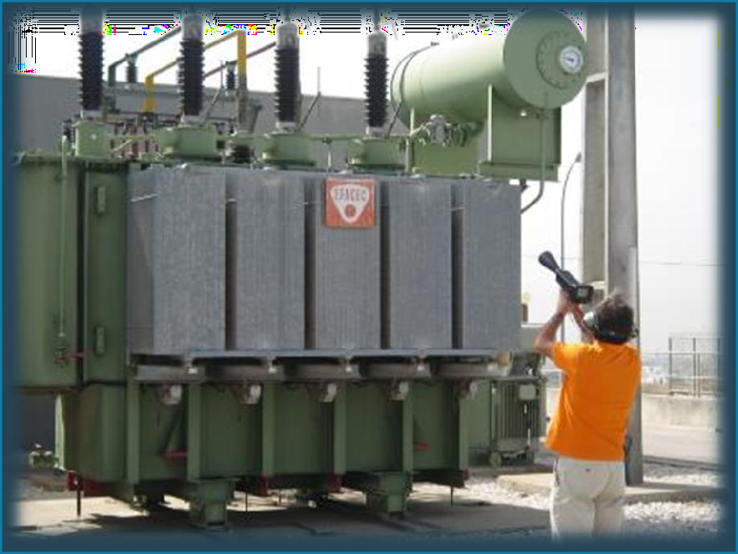


ELECTRICAL INSPECTION Identifying Faults
Finding an Electrical Fault in Transformer from Bushings & Tank Body
Use Non Contact – Air borne sensor to detect partial discharges from bushings from safe distance at 40 K Hz
Use Contact- Structure borne sensor to identify discharge from Tank body at frequency 20 KHz

Slide 3
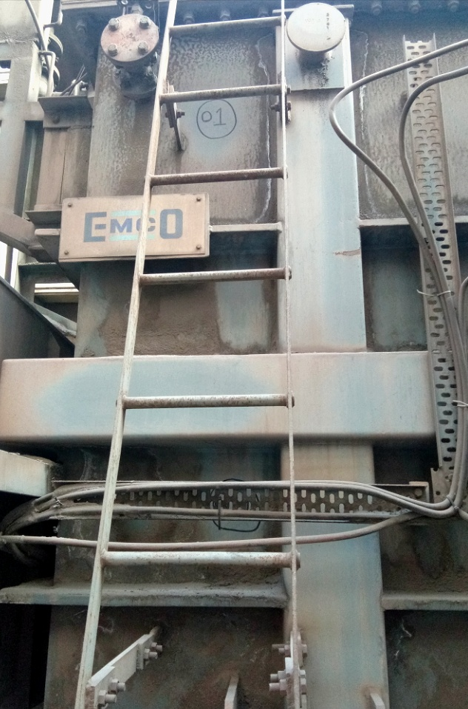
Method of Inspection- From Tank
zones were marked on the transformer tank
Data collected and recorded for one minute each zone.
Ultraprobe 15000 with magnetic sensor was used.
Data collected from 22 zones around the tank.
01
02
03
04

Slide 4
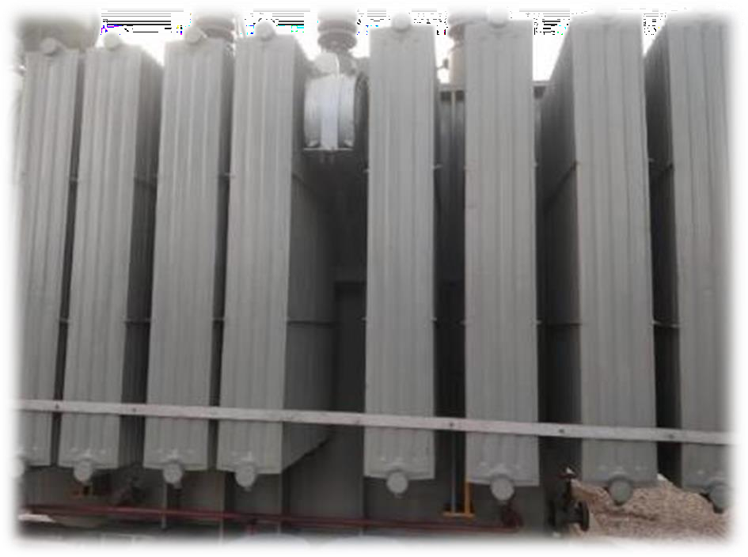
DETECTION & LOCATION IDENTIFICATION
Transformer Internal discharge can also be measure with using ultrasound with help of Stethoscope module/Magnetic sensor at 20 kHz frequency.
mark equidistant points and take readings, sound intensity will be grater at source. Hence we can pin point.
If you get electrical discharge pattern in signature, please proceed for DGA and Furan Test for confirmation of partial discharge in within Transformer.
HV
Ultrasound discharge found
No Ultrasound for Discharge
No Ultrasound for Discharge
Industry : Steel Plant Instrument : UP15000

Slide 5
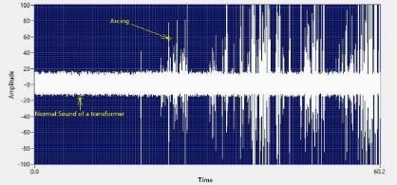


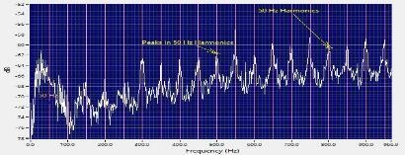
DETECTION EXAMPLE
Please clock on media file to hear the sound pattern
FFT Analysis- Peaks at 50 Hz line frequency is clearly visible
Time series pattern indicates arcing inside the transformer.
Industry : Refinery Instrument : UP15000

Slide 6
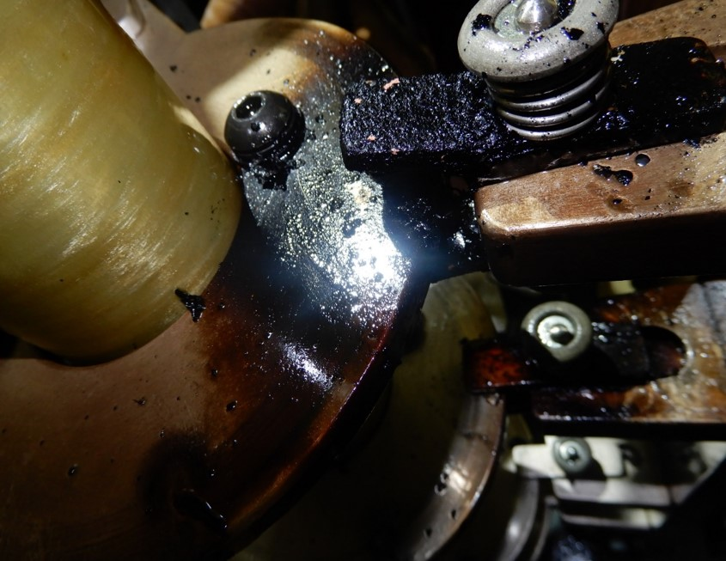
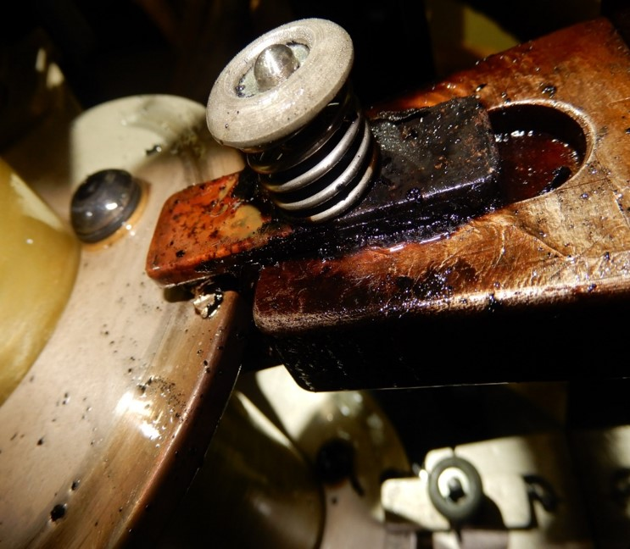
Photos during physical after shutdown

